Slide 1
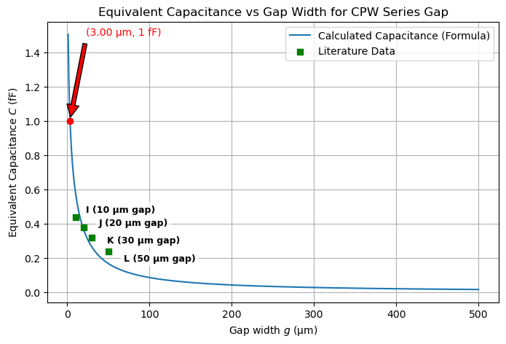
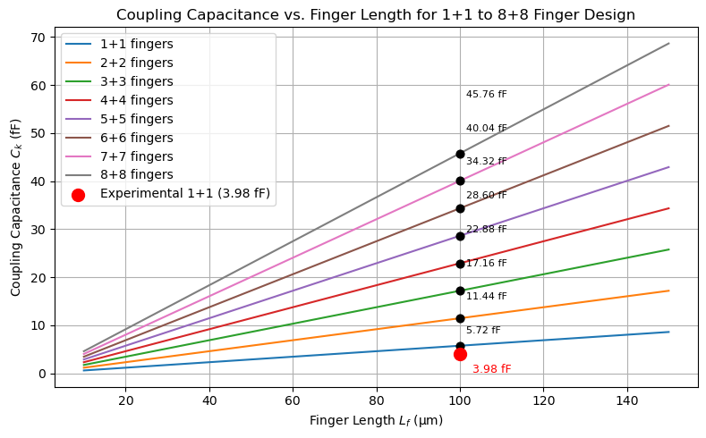
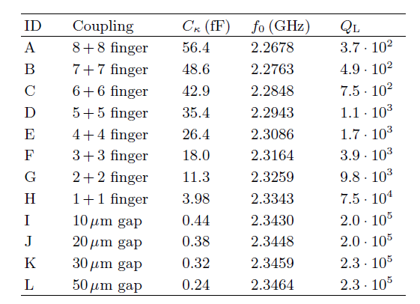
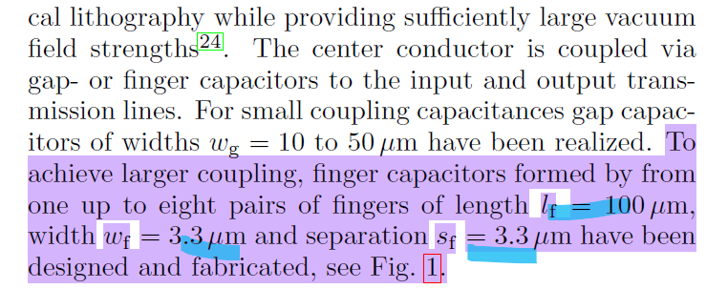
Gap & IDC Calculation/Formula used - Overview
Both plots were used to verify the formula against the literature
Paper used: https://arxiv.org/abs/0807.4094
Check the code used for the ID –
capacitor in the notes
Capacitance (fF) | Gap Width (μm) |  | Resonant Frequency f0 (THz) | Resonant Length l (µm)
0.265 | 30 |  | 0.3 | 178.57
0.5 | 13 |  | 0.5 | 107.14
1 | 3 |  | 0.8 | 66.96
5 | 1.14
10 | 0.55
20 | 0.3
Notes:
# -*- coding: utf-8 -*-
"""
Created on Mon Jun 30 18:37:02 2025
@author: abkhu
"""
import numpy as np
import matplotlib.pyplot as plt
from scipy.special import ellipk
# Constants
epsilon_0 = 8.854e-12 # Vacuum permittivity (F/m)
epsilon_eff = 5.05 # Effective dielectric constant from paper
# Finger parameters (in meters)
w = 3.3e-6 # Finger width (3.3 µm)
s = 3.3e-6 # Finger spacing (3.3 µm)
lf_range = np.linspace(10e-6, 150e-6, 500) # Finger length from 10 µm to 150 µm
def capacitance_per_length(w, s, epsilon_eff):
"""
Calculate capacitance per unit length (F/m) using conformal mapping.
"""
k = w / (w + 2 * s)
k_prime = np.sqrt(1 - k**2)
K_k = ellipk(k**2)
K_k_prime = ellipk(k_prime**2)
cf = 2 * epsilon_0 * epsilon_eff * K_k / K_k_prime
return cf # F/m
# Compute per unit length capacitance
cf = capacitance_per_length(w, s, epsilon_eff) # F/m
plt.figure(figsize=(8,5))
# Plot for multiple finger pairs (1+1 up to 8+8)
for fingers in range(1, 9):
C_total = cf * lf_range * fingers # Total capacitance = per length * finger length * number of pairs
C_total_fF = C_total * 1e15
plt.plot(lf_range * 1e6, C_total_fF, label=f'{fingers}+{fingers} fingers')
# Experimental value for 1+1 fingers at 100 µm
lf_exp = 100e-6
C_exp = 3.98 # fF (from paper)
plt.scatter([lf_exp * 1e6], [C_exp], color='red', label='Experimental 1+1 (3.98 fF)', zorder=5, s=100)
# Model value for 1+1 fingers at 100 µm
C_model_exp = cf * lf_exp * 1e15 # in fF
plt.scatter([lf_exp * 1e6], [C_model_exp], color='green', label=f'Model 1+1 at 100 µm ({C_model_exp:.2f} fF)', zorder=6, s=100)
plt.title('Coupling Capacitance vs. Finger Length for 1+1 to 8+8 Finger Design')
plt.xlabel('Finger Length $L_f$ (µm)')
plt.ylabel('Coupling Capacitance $C_k$ (fF)')
plt.grid(True)
plt.legend(loc='upper left')
plt.tight_layout()
plt.show()

Slide 2
Gap Capacitor Design & Calculation/Formula

Slide 3
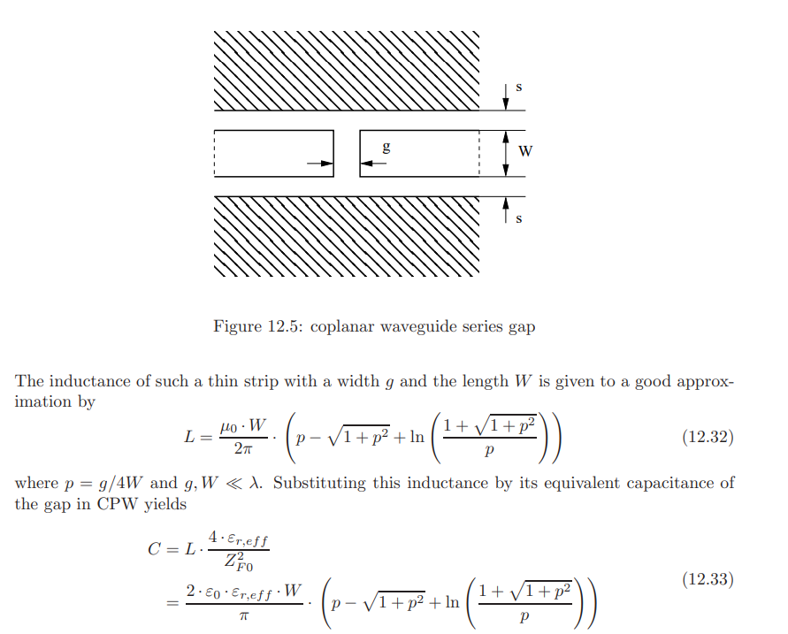
Formula Validity: Equivalent Capacitance for CPW Series Gap
For my case with W=10μm, g=3μm, and operating at 0.5 THz (λ=600μm), these dimensions (W, g) are well within the lumped-element approximation regime (λ/10)
Using the inductance calculated this way, and applying the duality between inductance and capacitance in transmission lines, we can find the equivalent capacitance C of the gap

Slide 4
Validation of Gap Capacitance Formula Against Literature Values
Context/Assumptions
From the plot (mainly from 3 µm to 10 µm gap):
At a 3 µm gap, the capacitance C≈1 fF.
At a 10 µm gap, the capacitance decreases roughly by a factor of about 2.5 to 3, so the estimated C≈0.3−0.4 fF.
Capacitance values at different frequencies (GHz vs THz), slight variation expected.
This is a reasonably close and acceptable agreement between the formula and the table value, supporting the formula’s validity.
Check the code used for the Gap – capacitor in the notes
Notes:
# -*- coding: utf-8 -*-
"""
Created on Mon Jun 30 22:00:31 2025
@author: abkhu
"""
# -*- coding: utf-8 -*-
"""
Created on Sun Jun 22 01:59:51 2025
@author: abkhu
"""
import numpy as np
import matplotlib.pyplot as plt
import math
def calculate_cpw_gap_capacitance(g, W, epsilon_r_eff):
epsilon_0 = 8.854187817e-12 # F/m vacuum permittivity
p = g / (4 * W)
p = np.maximum(p, 1e-12) # prevent log(0)
term = p - np.sqrt(1 + p**2) + np.log((1 + np.sqrt(1 + p**2)) / p)
C = (2 * epsilon_0 * epsilon_r_eff * W / math.pi) * term
return C
# Parameters
W = 10e-6 # 10 microns strip length
epsilon_r_eff = 7.84 # Effective relative permittivity
# Generate gap values from 1 micron to 500 microns
g_min = 1e-6
g_max = 5e-4
gaps = np.linspace(g_min, g_max, 500)
# Compute capacitance for each gap using the formula
capacitances = calculate_cpw_gap_capacitance(gaps, W, epsilon_r_eff)
# Find gap closest to 1 fF capacitance
target_C = 1e-15 # 1 femtofarad in Farads
index_closest = np.argmin(np.abs(capacitances - target_C))
g_at_1fF = gaps[index_closest]
print(f"Gap width g at 1 fF capacitance is approximately {g_at_1fF*1e6:.2f} microns")
# Literature/reference capacitance data points with IDs (excluding 3 um gap)
literature_ids = ['I (10 μm gap)', 'J (20 μm gap)', 'K (30 μm gap)', 'L (50 μm gap)']
literature_gaps = np.array([10, 20, 30, 50])
literature_caps = np.array([0.44, 0.38, 0.32, 0.24])
# Plot all
plt.figure(figsize=(8,5))
plt.plot(gaps * 1e6, capacitances * 1e15, label='Calculated Capacitance (Formula)')
plt.scatter(literature_gaps, literature_caps, color='green', marker='s', label='Literature Data', zorder=5)
# Annotate literature points with smaller text and background box for clarity
for gap, cap, label in zip(literature_gaps, literature_caps, literature_ids):
plt.annotate(label,
(gap, cap),
textcoords="offset points",
xytext=(8, 6),
ha='left',
fontsize=9,
fontweight='bold',
color='black',
bbox=dict(boxstyle='round,pad=0.3', fc='white', alpha=0.75, lw=0))
# Mark the 1 fF point on the plot
plt.scatter(g_at_1fF * 1e6, 1, color='red', zorder=6)
plt.annotate(f'({g_at_1fF*1e6:.2f} μm, 1 fF)',
xy=(g_at_1fF * 1e6, 1),
xytext=(g_at_1fF*1e6+20, 1.5),
arrowprops=dict(facecolor='red', shrink=0.05),
fontsize=10,
color='red')
plt.xlabel('Gap width $g$ (μm)')
plt.ylabel('Equivalent Capacitance $C$ (fF)')
plt.title('Equivalent Capacitance vs Gap Width for CPW Series Gap')
plt.grid(True)
plt.legend()
plt.show()

Slide 5
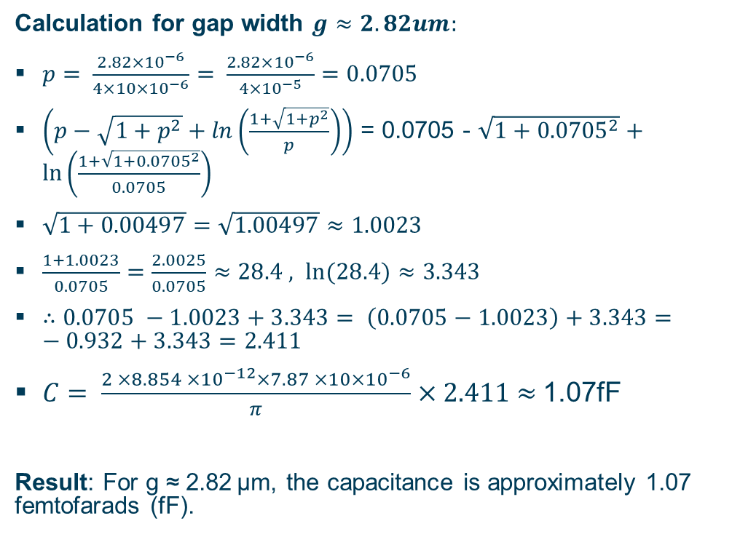
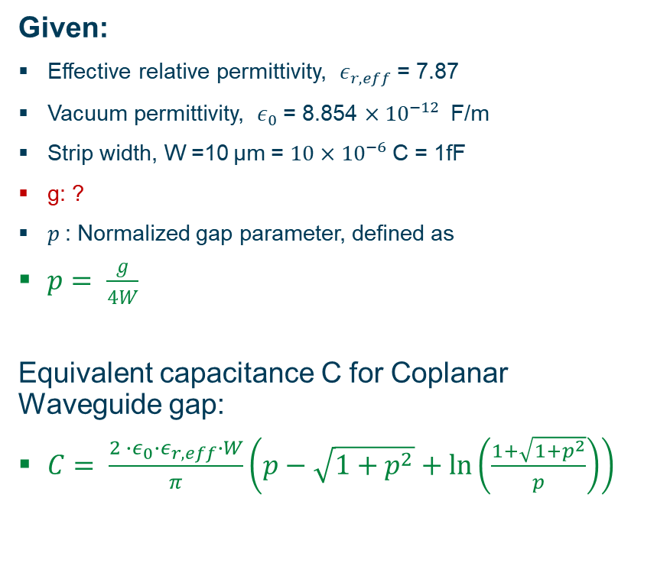
Calculation of Equivalent Capacitance for CPW Gap
Given:
Effective relative permittivity, $ε_{r,eff}$= 7.87
Vacuum permittivity, $ε_{0}$= 8.854 ${×10}^{−12}$ F/m
Strip width, W =10 μm = $10{×10}^{−6}$C = 1fF
g: ?
$p$: Normalized gap parameter, defined as
$p= \frac{g}{4W}$
Equivalent capacitance C for Coplanar Waveguide gap:
$C= \frac{2 ∙ε_{0}∙ε_{r,eff}∙W}{π}\left(p−\sqrt{1+p^{2}}+\ln\left(\frac{1+\sqrt{1+p^{2}}}{p}\right)\right)$
Calculation for gap width $g≈2.82um:$
$p= \frac{2.82×{10}^{−6}}{4×10×{10}^{−6}}= \frac{2.82×{10}^{−6}}{4×{10}^{−5}}=0.0705$
$\left(p−\sqrt{1+p^{2}}+\ln\left(\frac{1+\sqrt{1+p^{2}}}{p}\right)\right)$ = 0.0705 - $\sqrt{1+{0.0705}^{2}}+\ln\left(\frac{1+\sqrt{1+{0.0705}^{2}}}{0.0705}\right)$
$\sqrt{1+0.00497}=\sqrt{1.00497}≈1.0023$
$\frac{1+1.0023}{0.0705}=\frac{2.0025}{0.0705}≈28.4 , \ln{(28.4)≈3.343}$
$∴0.0705 −1.0023+3.343= \left(0.0705−1.0023\right)+3.343=−0.932+3.343=2.411$
$C= \frac{2 ×8.854 ×{10}^{−12}×7.87 ×10×{10}^{−6}}{π}×2.411$ $≈$1.07fF
Result: For g ≈ 2.82 μm, the capacitance is approximately 1.07 femtofarads (fF).

Slide 6


Calculated Resonant Length ($l$)
Formula:
$l =\frac{c}{2n_{eff}f_{0}}$
$f_{0}$ = Resonant frequency = 0.3, 0.5, 0.7 THz
c = Speed of light in vacuum (approximately $3x{10}^{8}$ m/s)
$l=$ Resonant length (length of the resonator) = ?
$n_{eff}$= Effective refractive index (dimensionless) = 2.8
@ $f_{0}$ =0.3THz
$l$= 179um
@ $f_{0}$ =0.5THz
$l$=107um
@ $f_{0}$ =0.8THz
$l$=66.96um

Slide 7
Interdigitated Capacitor Design & Calculation

Slide 8
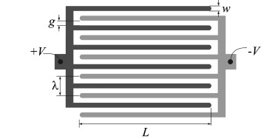
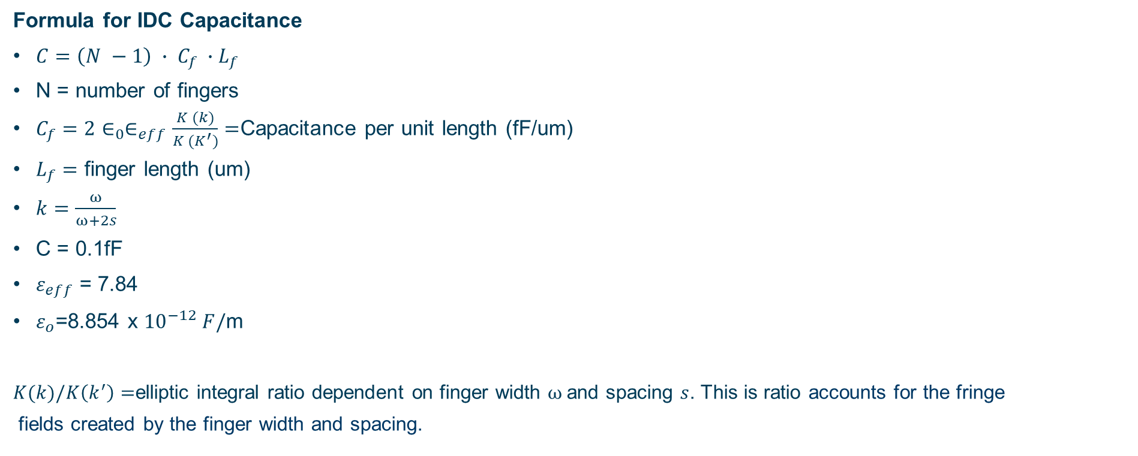
Conformal mapping theory - model the interdigitated capacitor (IDC) capacitance.
Formula for IDC Capacitance
$C=\left(N −1\right) ∙ C_{f} ∙L_{f}$
N = number of fingers
$C_{f}=2∈_{0}∈_{eff}\frac{K (k)}{K (K^{′})}=$Capacitance per unit length (fF/um)
$L_{f}=$ finger length (um)
$k=\frac{ω}{ω+2s}$
C = 0.1fF
$ε_{eff}$ = 7.84
$ε_{o}$=8.854 x ${10}^{−12} F/$m
$K(k)/K\left(k^{′}\right)=$elliptic integral ratio dependent on finger width $ω$and spacing $s$. This is ratio accounts for the fringe
fields created by the finger width and spacing.
Notes:
# -*- coding: utf-8 -*-
"""
Created on Mon Jun 30 18:37:02 2025
@author: abkhu
"""
import numpy as np
import matplotlib.pyplot as plt
from scipy.special import ellipk
# Constants
epsilon_0 = 8.854e-12 # Vacuum permittivity (F/m)
epsilon_eff = 5.05 # Effective dielectric constant from paper
# Finger parameters (in meters)
w = 3.3e-6 # Finger width (3.3 µm)
s = 3.3e-6 # Finger spacing (3.3 µm)
lf_range = np.linspace(10e-6, 150e-6, 500) # Finger length from 10 µm to 150 µm
def capacitance_per_length(w, s, epsilon_eff):
"""
Calculate capacitance per unit length (F/m) using conformal mapping.
"""
k = w / (w + 2 * s)
k_prime = np.sqrt(1 - k**2)
K_k = ellipk(k**2)
K_k_prime = ellipk(k_prime**2)
cf = 2 * epsilon_0 * epsilon_eff * K_k / K_k_prime
return cf # F/m
# Compute per unit length capacitance
cf = capacitance_per_length(w, s, epsilon_eff) # F/m
plt.figure(figsize=(8,5))
# Plot for multiple finger pairs (1+1 up to 8+8)
for fingers in range(1, 9):
C_total = cf * lf_range * fingers # Total capacitance = per length * finger length * number of pairs
C_total_fF = C_total * 1e15
plt.plot(lf_range * 1e6, C_total_fF, label=f'{fingers}+{fingers} fingers')
# Experimental value for 1+1 fingers at 100 µm
lf_exp = 100e-6
C_exp = 3.98 # fF (from paper)
plt.scatter([lf_exp * 1e6], [C_exp], color='red', label='Experimental 1+1 (3.98 fF)', zorder=5, s=100)
# Model value for 1+1 fingers at 100 µm
C_model_exp = cf * lf_exp * 1e15 # in fF
plt.scatter([lf_exp * 1e6], [C_model_exp], color='green', label=f'Model 1+1 at 100 µm ({C_model_exp:.2f} fF)', zorder=6, s=100)
plt.title('Coupling Capacitance vs. Finger Length for 1+1 to 8+8 Finger Design')
plt.xlabel('Finger Length $L_f$ (µm)')
plt.ylabel('Coupling Capacitance $C_k$ (fF)')
plt.grid(True)
plt.legend(loc='upper left')
plt.tight_layout()
plt.show()

